Slide 1



Brian Vineyard: VG Analysis
View in Power BI
Last data refresh:
8/15/2023 4:16:14 PM UTC
Downloaded at:
8/15/2023 7:29:46 PM UTC

Slide 2
Analysis of Video Game Sales dataset from Kaggle:
https://www.kaggle.com/datasets/gregorut/videogamesales/download?datasetVersionNumber=2
This dashboard was completed in less than 2 days, and includes the following features:
Executive Dashboard: Sales Totals by Region, Sales by Genre, Sales by Platform, Top Selling Titles, Sales by Year
Breakdown by Genre: Top selling titles for the top 3 genres: Action, Sports, and Shooter, Releases by Year
North American Analysis: Sales by Publisher, Game Count by Publisher, Decomposition Tree showing top sales drilldown
Key Influencers: Power BI analysis of factors that cause Global Sales to increase or decrease

Slide 3
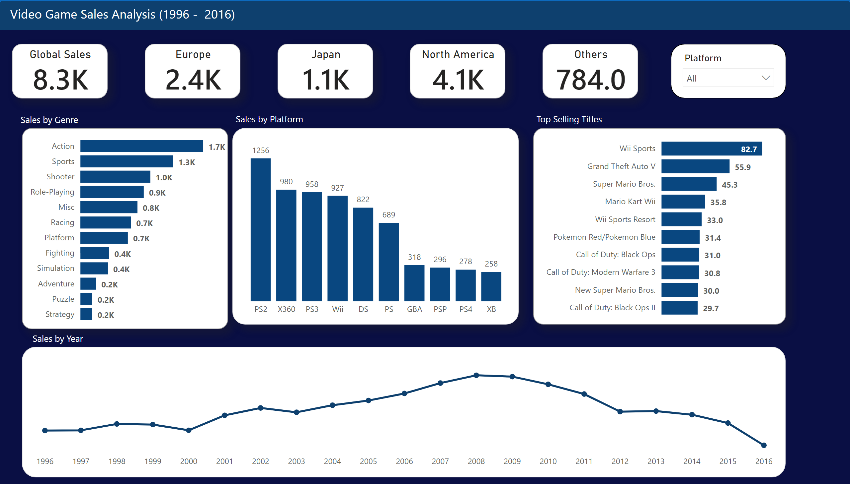
Video Game Sales Report
Notes:
Global Sales
No alt text provided
Global Sales by Genre
No alt text provided
Top 10 Global Sales by Title
No alt text provided
columnChart
No alt text provided
slicer
No alt text provided
textbox
No alt text provided
textbox
No alt text provided
shape
No alt text provided
lineChart
No alt text provided
Europe
No alt text provided
Japan
No alt text provided
North America
No alt text provided
Others
No alt text provided
textbox
No alt text provided
textbox
No alt text provided
textbox
No alt text provided

Slide 4
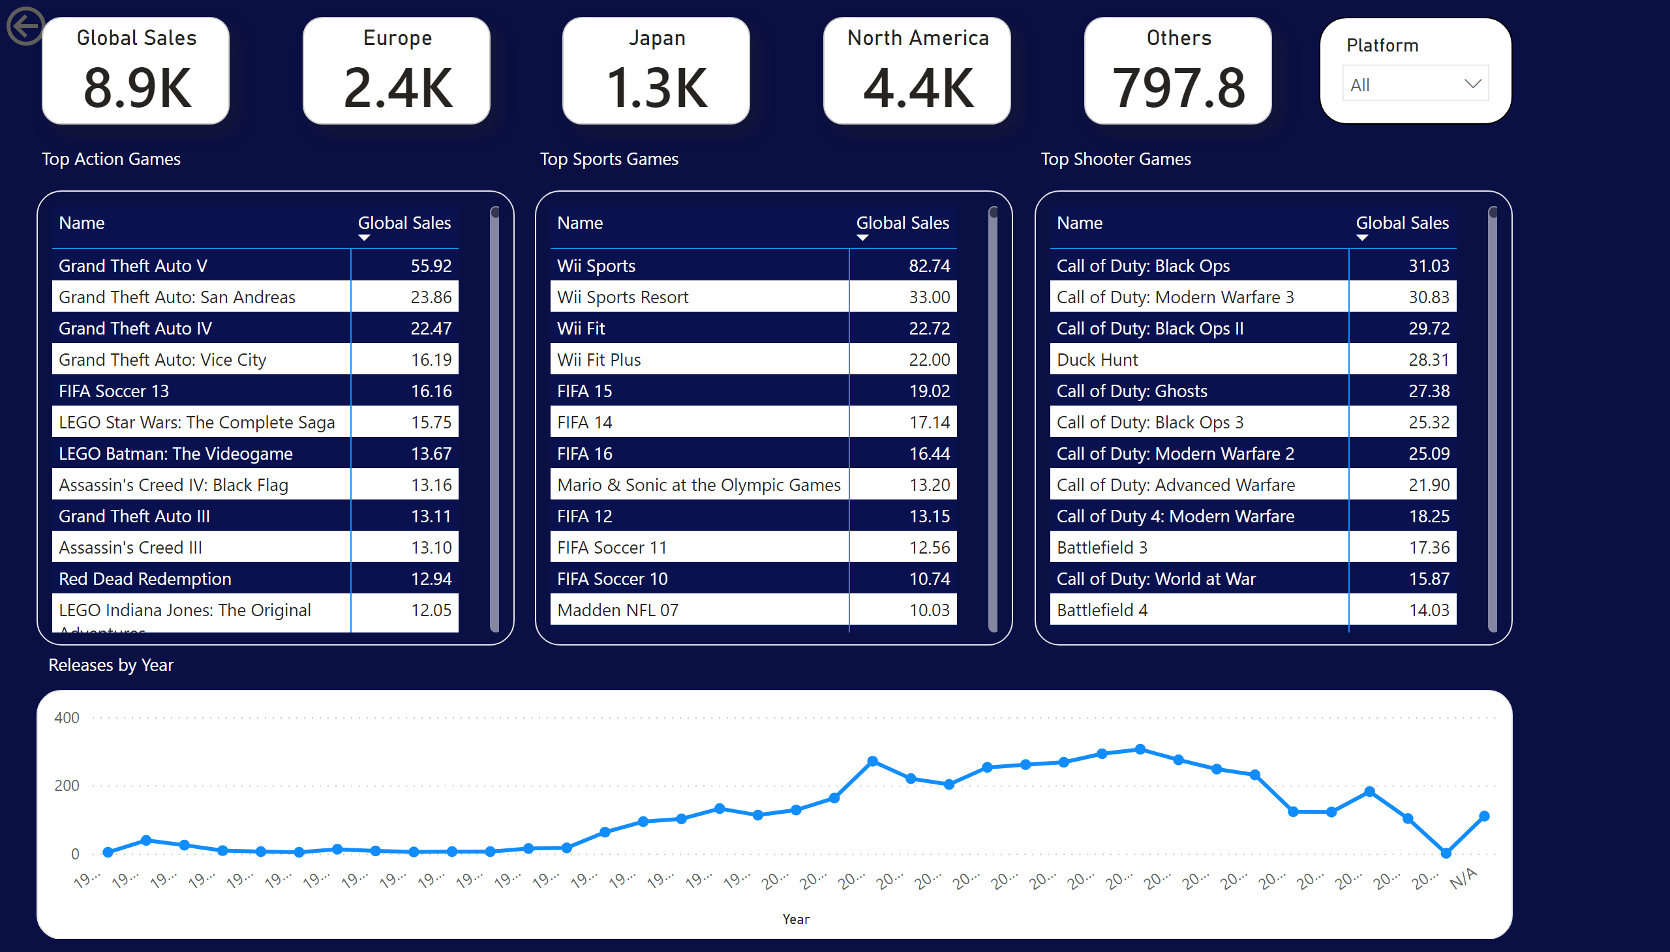
Top Genre Breakdown
Notes:
actionButton
No alt text provided
pivotTable
No alt text provided
textbox
No alt text provided
pivotTable
No alt text provided
pivotTable
No alt text provided
textbox
No alt text provided
textbox
No alt text provided
Global Sales
No alt text provided
slicer
No alt text provided
Europe
No alt text provided
Japan
No alt text provided
North America
No alt text provided
Others
No alt text provided
lineChart
No alt text provided
textbox
No alt text provided

Slide 5
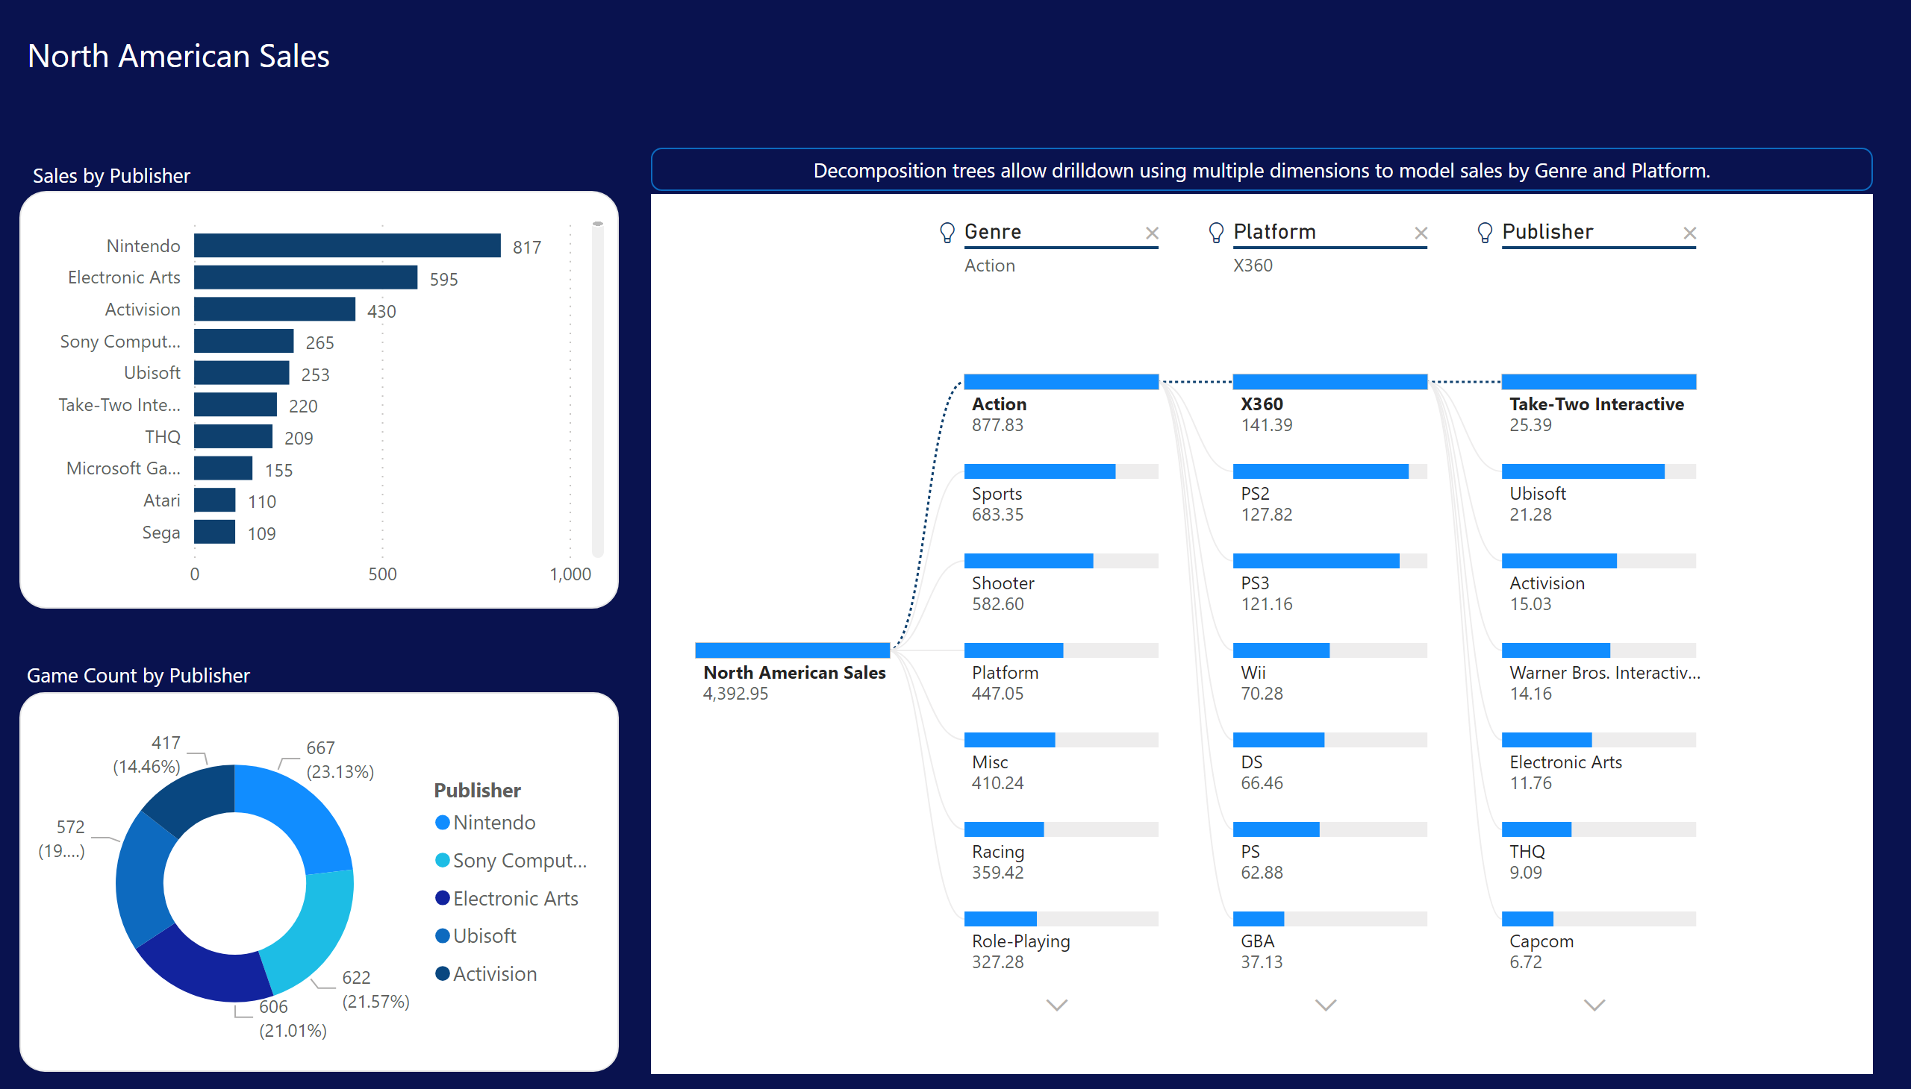
North American Sales Analysis
Notes:
barChart
No alt text provided
donutChart
No alt text provided
textbox
No alt text provided
textbox
No alt text provided
decompositionTreeVisual
No alt text provided
shape
No alt text provided
textbox
No alt text provided

Slide 6
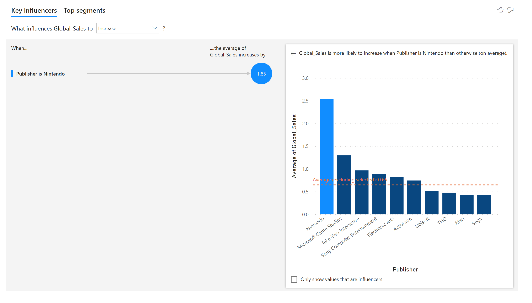
Key Influencers
Notes:
keyDriversVisual
No alt text provided

